Slide 1
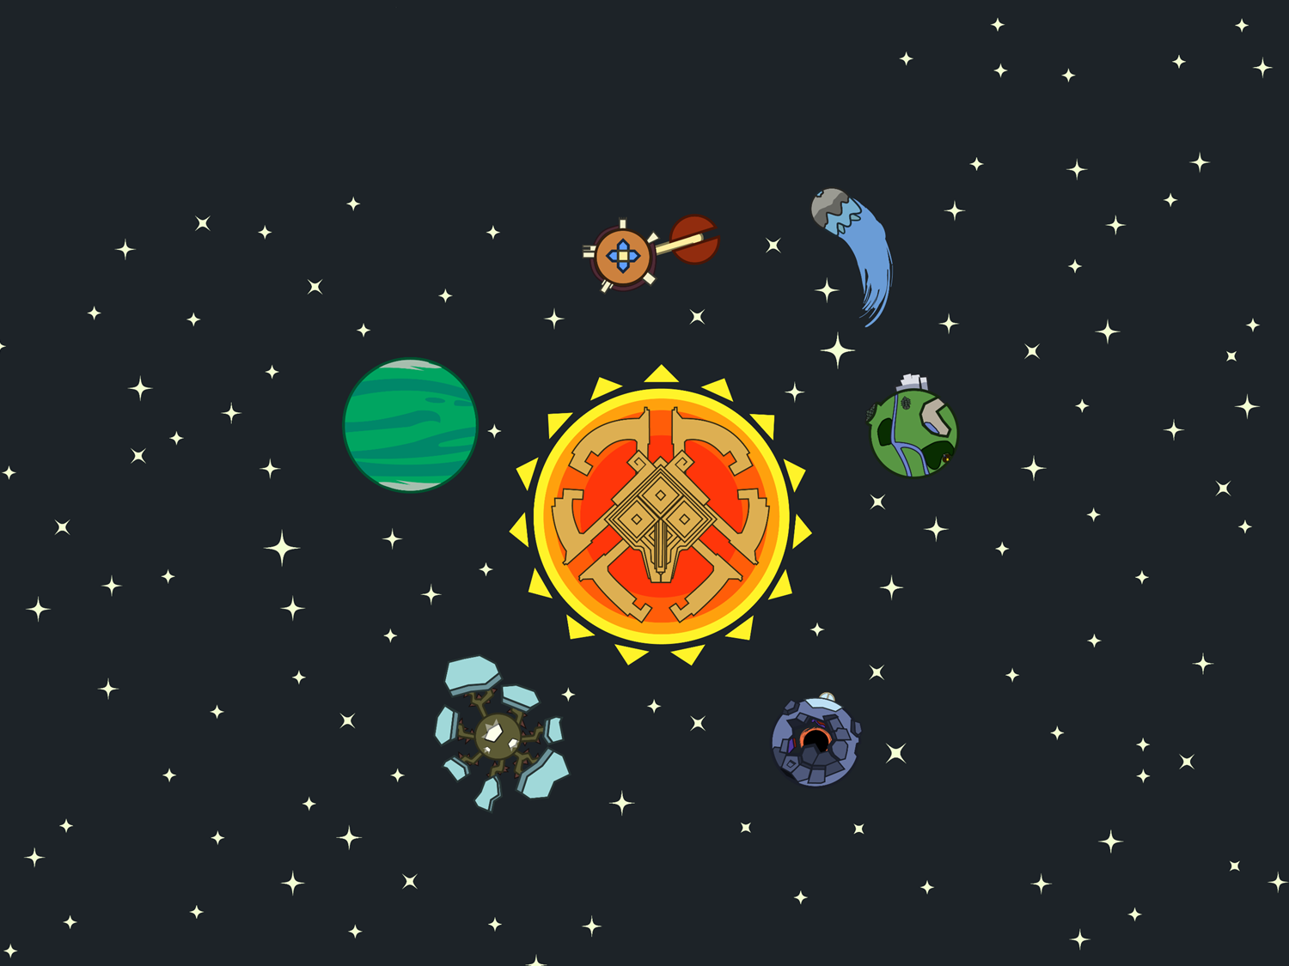
Informática II - Módulo 1
Arreglos multidimensionales
Module 8
Multidimensional Arrays

Slide 2




Multidimensional arrays
Multidimensional arrays are data structures that allow you to store data.
A multidimensional array is an array-of-arrays

Slide 3
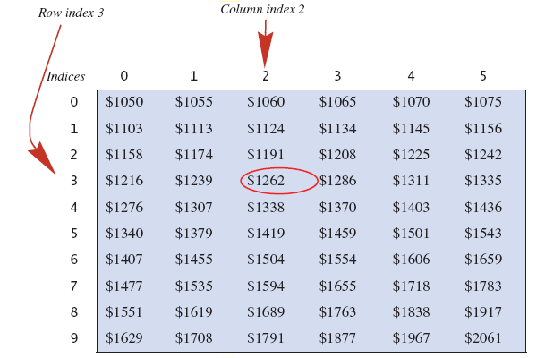


Multidimensional arrays
We can use the row index (3) and the column index (2) to retrieve the desired value.
table[3][2] has a value of 1262
The first index refers to the row, and the second index to the column.

Slide 4
Multidimensional array declaration
//Method 1: Declaration and instantiation
int[][] x1 = new int[3][3];
int x2[][] = new int[3][3];
// Method 2: Explicit initialization
int[][] x3 = {{1,2,3},{4,5,6},{7,8,9}};
//Method 3: Declaration and instantiation
int[][] x4 = new int[3][];
x4[0] = new int[3];
x4[1] = new int[3];
x4[2] = new int[3];

Slide 5
General declaration
data_type[][] variable_name = new data_type[rows][columns];
data_type: String, char, Scanner, int
variable_name: Identificador mediante el cual nos vamos a referir a la variable
rows y columns: Cantidad de filas y columnas

Slide 6
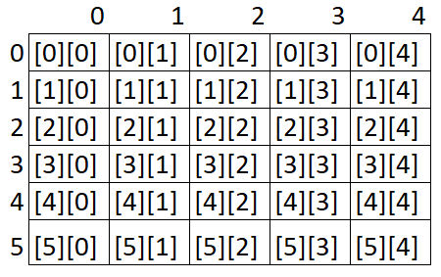
Multidimensional arrays

Slide 7
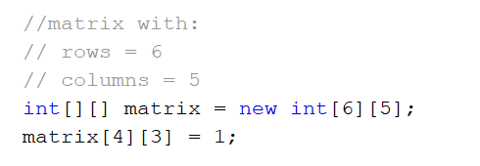
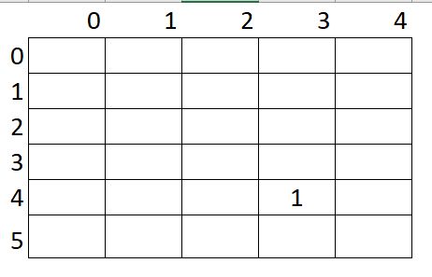
Array declaration

Slide 8
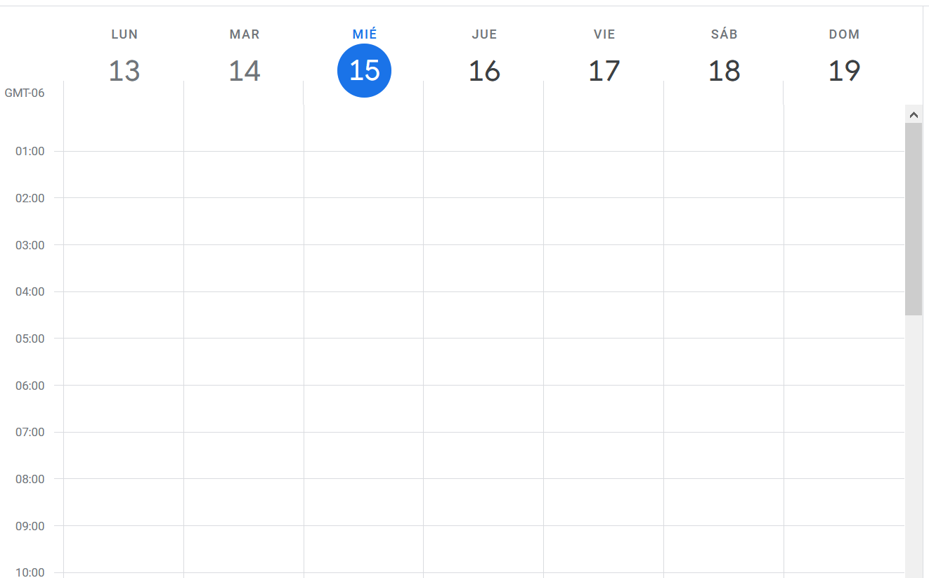
Example: Calendar
Design a method createCalendar() that instantiates and returns a multidimensional array that represents a calendar.
Each row will represent a 30-minute slot, and each column will represent one day of the week.
public static String[][] createCalendar(){
int rows = 48; // 48 slots of 30 minutes in a day
int columns = 7; // 7 days in a week
String[][] calendar = new String[rows][columns];
return calendar;
}

Slide 9
Matrix dimensions
The number of rows can be retrieved using the length attribute.
matrixName.length
The number of columns depends on each row, so we must use:
matrixName[row_index].length

Slide 10
Matrix
When we need to traverse a matrix, we use nested loops.
A nested loop means a loop inside of a loop.
for(int row = 0; row < matrix.length; row++){
for(int column = 0; column < matrix[row].length; column++) {
// Code here
}
}

Slide 11
Initializing a matrix
We can use a cycle:
int[][] matrix = new int[3][3];
int counter = 1;
for(int row = 0; row < matrix.length; row++){
for(int column = 0; column < matrix[row].length; column++) {
matrix[row][column] = counter++;
}
}
1
2
3
4
5
6
7
8
9

Slide 12
Add event
Design a method that adds an event to the calendar.
Inputs are:
Calendar reference (as a String matrix)
Name of the event (as a String)
Day (as an integer)
Time (as an integer)
If the even can be added, put it on the calendar and return TRUE. Otherwise, return FALSE.
public static boolean addEvent(String[][] calendar, String event, int day, int time){
// error!
if (calendar == null || calendar.length <= time || calendar[time].length <= day) {
return false;
}
if (calendar[time][day] != null)
return false;
calendar[time][day] = event;
return true;
}

Slide 13
Challenge!
Include a new parameter “duration” that allows the programmer to indicate how long the event will last. Assume the duration will be received in multiples of 30 minutes.
public static boolean addEvent(String[][] calendar, String event, int day, int time, int duration){
}

Slide 14
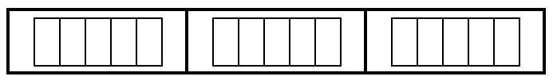
Representing a Matrix
A matrix can be represented as a table, or an array of arrays.
Ejemplo:
int[][] table = new int[3][5];

Slide 15
Ragged Arrays
Not all elements of an array have to be of the same size.
For example:
int[][] b;
b = new int[3][];
b[0] = new int[5]; //First row, 5 elements
b[1] = new int[7]; //Second row, 7 elements
b[2] = new int[4]; //Third row, 4 elements

Slide 16
Ragged arrays can be instantiated implicitly. Both arrays (a and b) are identical.
int[][] b;
b = new int[3][];
b[0] = new int[5]; //First row, 5 elements
b[1] = new int[7]; //Second row, 7 elements
b[2] = new int[4]; //Third row, 4 elements
int[][] c = {{0,0,0,0,0}, //First row, 5 elements
{0,0,0,0,0,0,0}, //Second row, 7 elements
{0,0,0,0}}; //Third row, 4 elements

Slide 17

Ragged Arrays

Slide 18
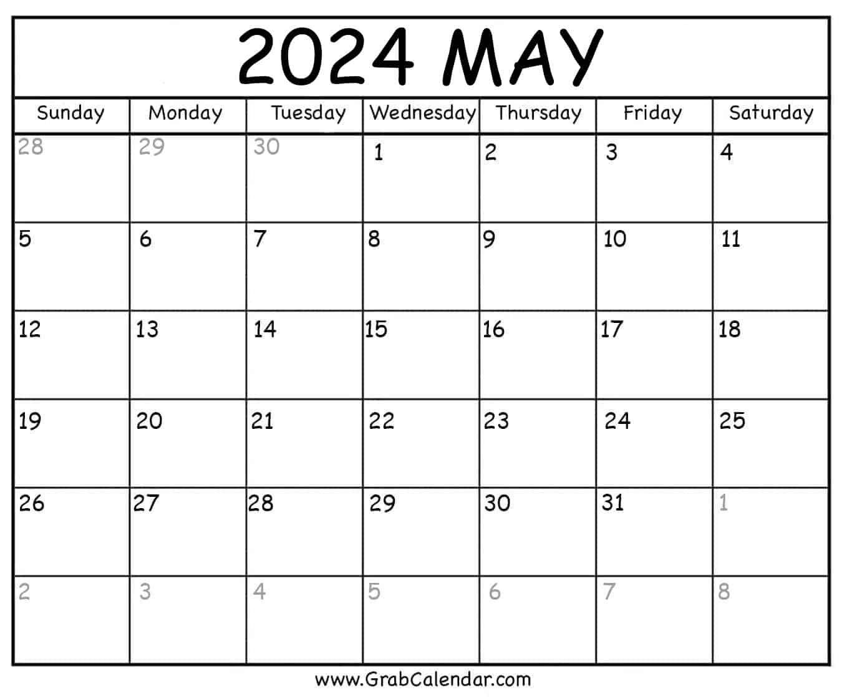
Example
Declare and initialize a matrix of integers to represent the month of May 2024. Notice that not all weeks have the same number of days.
Assign the number of the day to each element.

